Slide 1


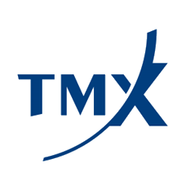



Corporate Presentation
August 2026
: AMT
: AMTFF
@ameritrustfintech
@ameri_trust
Confidential

Slide 2

Forward Looking Statements
This presentation contains "forward-looking information" within the meaning of Canadian securities legislation. All information contained herein that is not clearly historical in nature may constitute forward-looking information. Generally, such forward- looking information can be identified by the use of forward-looking terminology such as "plans", "expects" or "does not expect", "is expected", "budget", "scheduled", "estimates", "forecasts", "intends", "anticipates" or "does not anticipate", or "believes", or variations of such words and phrases or state that certain actions, events or results "may", "could", "would", "might" or "will be taken", "occur" or "be achieved". Forward-looking information is subject to known and unknown risks, uncertainties and other factors that may cause the actual results, level of activity, performance or achievements of the Company to be materially different from those expressed or implied by such forward-looking information, including but not limited to: (i) volatile stock price; (ii) the general global markets and economic conditions; (iii) the health of the automotive industry in the markets where the Company wishes to operate; (iv) the risk associated with development and maintenance of software products; (v) competition faced by the Company in securing experienced personnel and financing; (vi) competition from other players in the market, including those with more resources and history: and (vii) the reliance on key personnel.
Forward-looking information is based on assumptions management believes to be reasonable at the time such statements are made, including but not limited to, continued success in software development, access to qualified sales force, continued involvement of current management, automotive industry activity levels remaining constant, receipt of required regulatory approvals, and such other assumptions and factors as set out herein. Although the Company has attempted to identify important factors that could cause actual results to differ materially from those contained in the forward-looking information, there may be other factors that cause results not to be as anticipated, estimated or intended. There can be no assurance that such forward- looking information will prove to be accurate, as actual results and future events could differ materially from those anticipated in such forward- looking information. Such forward-looking information has been provided for the purpose of assisting investors in understanding the Company's business, operations and exploration plans and may not be appropriate for other purposes. Accordingly, readers should not place undue reliance on forward-looking information. Forward-looking information is made as of the date hereof, and the Company does not undertake to update such forward-looking information except in accordance with applicable securities laws. Neither the TSXV nor its Regulation Services Provider (as that term is defined in the policies of the TSXV) accepts responsibility for the adequacy or accuracy of this presentation. Forward-looking information is based on assumptions management believes to be reasonable at the time such statements are made.
2

Slide 3
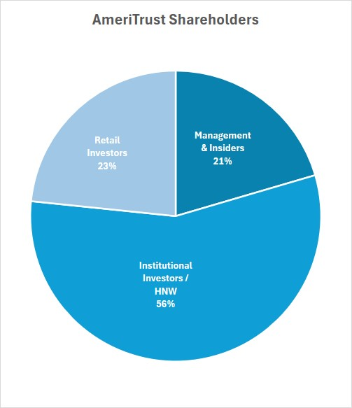
Investor Snapshot
Stock Exchanges and Ticker Symbols | TSXV: AMT
 | OTCQB: AMTFF
Management & Insider Ownership | 21%
Average Daily Trading Volume | 8.9M
(last 3 months)
Last Price | CAD $0.215
Shares Issued and Outstanding | 1.07B
Warrants | 657.6M
Options | 26.3M
Restricted Share Units | 21.2M
Capital Structure – Fully Diluted | 1.78B
Current Market Cap | CAD $230.8M
Cash Balance - June 30, 2026 | CAD $36.4M
Cash from Exercised Warrants | CAD $5.1M
As of August 20, 2026
3

Slide 4
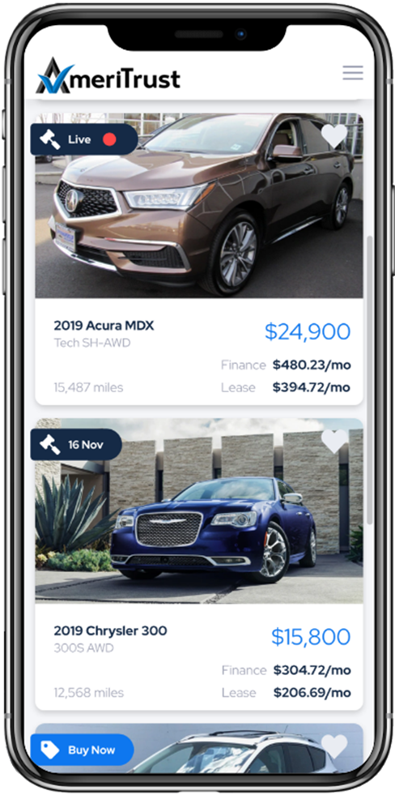
Executive Summary
AmeriTrust Financial Technologies Inc. (TSXV: AMT, OTCQB: AMTFF) is listed on the TSX Venture Exchange and is a finance technology and data company that utilizes proprietary technology to be an industry leader in Auto Finance, Servicing, and Remarketing. Its technology stack resulted in the Company becoming the National Lease Partner to Tesla in 2018.
While the Company provides diversity through multiple revenue stream’s, the core business is offering a leasing alternative for used vehicles. This business model is unique in the US market and is driven through its proprietary technology.
Auto Leasing makes up 25% of the new vehicle market and is controlled by the manufacturers. Used vehicle leases make up less than 2% of the market and is limited primarily to “certified pre-owned” programs controlled by the OEM’s (Ford, General Motors, Mercedes Benz).
Traditionally, the only way for US consumers to participate in the used vehicle market has been through retail financing which requires high up-front costs, and steeper monthly payments.
The Company’s differentiated used vehicle leasing technology presents an economic option for US customers who have seen their vehicle affordability decrease in recent years amidst rising inflation and high interest rates.
AmeriTrust’s proprietary leasing solutions offer customers attractive opportunities with lower monthly payments, providing a dealer additional sales opportunities through new financing products and providing lending partners higher risk adjusted returns with better risk profiles for greater security and predictability.
AmeriTrust’s business model has three primary revenue streams: AmeriTrust Financial; AmeriTrust Serves; and, AmeriTrust Auto.
Confidential
4

Slide 5
Q2 2026 Financial and Operational Performance
Funded lease contract growth accelerated in Q2 2026, with an increase of 205% in the value of contracts financed over Q1 2026
During the second quarter of 2026 AmeriTrust received 1,285 applications representing approximately $67 million in potential funding opportunities, approved or conditionally approved 126 consumer applications, and funded 55 lease contracts. The weighted average credit score of funded customers in the second quarter was 737, the weighted average contract rate was 9.02%, and the weighted average net capitalized cost (amount financed) of the lease contracts was CAD $115,593.
Total funded contracts increased sequentially each month during the quarter, with lease origination income increasing from $101,985 in Q1 2026 to $330,515 in Q2 2026. The total contracted cash flows associated with the funded contracts increased from $1,783,472 in Q1 2026 to $5,522,646 in Q2 2026, over the terms of the respective leases.
The total contracted cash flows associated with all funded contracts in Q1 and Q2 2026 is approximately $7,306,118, over the terms of the respective leases.
Year-to-date performance continues to validate the Company’s strategy. AmeriTrust originated as much business in June and July as it did during all the prior months combined. July originations increased 38% over June, reflecting strong dealer demand and continued market momentum. The Company remains disciplined in managing originations to align with its high-prime portfolio objectives while positioning the Company for sustainable, profitable growth.
Confidential
5

Slide 6
Q2 2026 Financial and Operational Performance - continued
AmeriTrust’s current priorities and accomplishments include:
Expanded Funding Capacity: The Executive Team is actively engaged in discussions with multiple national financial institutions to expand the Company’s funding capacity while retaining servicing rights, positioning AmeriTrust to support our anticipated growth in lease originations.
Sales Team Expansion: AmeriTrust is significantly expanding our sales organization through the full rollout to Military AutoSource and the remaining 18 AutoSavvy locations. We now have 12 dealer representatives covering key markets, including Dallas, Fort Worth, Houston, Oklahoma, Jacksonville, Miami, Las Vegas, Phoenix, San Diego, Michigan, New Jersey, New York, Alabama, and additional Arizona markets.
Remarketing Operations: AmeriTrust Auto is negotiating brick-and-mortar locations to support the remarketing of off-lease vehicles, creating additional opportunities to enhance portfolio performance and reduce net cumulative loss.
Technology & Innovation: AmeriTrust’s technology teams are developing and integrating proprietary AI and machine learning solutions that will improve operational efficiency, increase accuracy, enhance decision-making, and support our continued nationwide expansion.
Servicing Platform: AmeriTrust Serves has successfully onboarded all lease customers to our customized servicing platform and has achieved full in-house servicing capabilities, providing greater operational control and an enhanced customer experience.
Confidential
6

Slide 7
Veteran Management Team
AmeriTrust’s management team brings decades of experience in building and leading successful specialty finance companies.
Executives | Background
Jeff Morgan Chief Executive Officer | Founder and CEO of AmeriTrust Partner and GM of Vehicle Leasing Inc. Brings more than 25 years of auto finance experience to MUSA
John Wimsatt Chief Investment Officer | Former CIO at ECN Capital Corp Institutional Investor 30 years experience in Specialty Finance with broad funding background
Euwye Chan Chief Accounting Officer | Highly accomplished accounting and finance professional MBA from Dallas Baptist University Over 20 years of finance-related experience
Shibu Abraham Chief Financial Officer | Publicly traded and private company expertise in the US and Canada CA, CPA and ACA holder 25+ years accounting and financial management experience
Jessica Cumbee SVP Compliance - General Council | accomplished automotive finance attorney licensed in multiple states and certified by the National Automotive Finance Association in Consumer Credit Compliance. held similar positions at Car Capital Technologies, Inc., Octane, and Tricolor Auto.
Richard Goldman VP Capital Markets | Co-founder of AutoSoldNow, later acquired by PowerBand / AmeriTrust 30+ years capital markets, public company experience Former President, CFO of TSXV listed company
Blake Kirk Chief Operating Officer | Auto finance executive with experience in customer service, collections & loss mitigation GM Financial, Exeter Finance, Sierra Auto Finance & Express Capital Services Brings more than 23 years of financial experience to AmeriTrust
Troy Hocker Chief Revenue Officer | Auto finance executive with experience at the largest direct to consumer leasing company in the US D&M Leasing Brings more than 20 years of auto finance experience to AmeriTrust
Sean Severin Chief Information Officer | Expertise in financial solutions, credit integration, and innovative product planning Proven leader in technology transformation, operations strategy, and team culture building Over 20 years of experience delivering impactful solutions through collaborative leadership
Xia Zhang Chief Technology Officer | Specialty in web application development Pivotal role in building AmeriTrust’s loan origination system (LOS) Brings more than 30 years of information technology experience
Confidential
7

Slide 8
AmeriTrust Overview
Company Background
Technology and Capabilities
Using proprietary technology, AmeriTrust has created an innovative automotive platform with a focus on an underserved market, used vehicle auto leasing.
AmeriTrust was originally founded by CEO Jeff Morgan as MUSA Auto Finance in Q2 2017. The Company developed a leading position in the prime market with an average lessee FICO score in excess of 700. The Company experienced significant growth and achieved superior portfolio performance due to several key dynamics:
AmeriTrust’s product offering streamlines leasing for consumers and dealers as well as incorporates first-of-its-kind technology to navigate the underwriting, funding, and delivery process, allowing AmeriTrust to complete the entire customer experience in minutes.
AmeriTrust’s portal automates the entire lease originations process.
Targeting creditworthy lessees with risk-based pricing.
Conservative data-driven approach for setting residuals utilizing third party data leader Automotive Lease Guide (“ALG”) projections.
Used car leasing remains ripe for deeper penetration due to limited competition.
Focused on building strong partnerships with a goal of being a full spectrum provider to customers nation wide.
Dedication to Proprietary Technology to disrupt the auto lease financing market.
AmeriTrust’s technology performs fraud checks, underwriting checks, and prepares for funding in minutes.
The Company’s cloud-based servicing platform (“AmeriTrust Serves”) efficiently tracks and monitors AmeriTrust’s portfolio.
Confidential
8

Slide 9
Why AmeriTrust
Proprietary technology-driven Dealer finance solution focused on new and used vehicle leasing.
Lease vs Loan Advantage
Lower monthly payments with less upfront costs.
Deeper Portfolio Penetration
Historic average FICO score of pool of 730+.
More profitable for Dealer Partners.
Shorter terms means more retention opportunities.
Higher lender yields.
Better credit performance.
Reduces risk of negative equity.
Lease opportunities throughout the credit scale.
Licensed in 42 states and growing.
Proprietary Dealer Solution
Integrated with RouteOne and DealerTrack.
Onboarded 700+ Dealers.
Recently announced strategic partnerships with AutoSavvy and Military AutoSource.
Dealer is notified in seconds if their customer is approved via automated decisioning technology.
Fast Funding
Automated solution will provide same day funding within hours of receipt of completed contracts.
Market Penetration
9

Slide 10
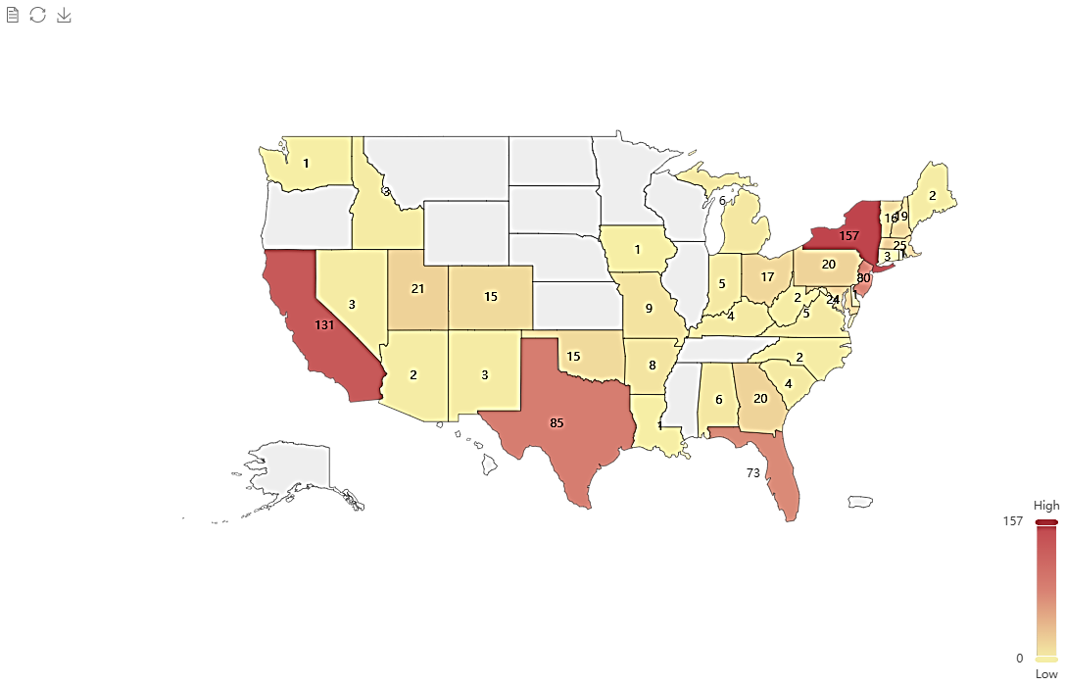
Dealer Expansion
AmeriTrust Financial
AmeriTrust Dealers by State
The Company is licensed in 42 states and Washington D.C.
The potential AmeriTrust dealer market in the USA
Dealer Portal training and lease product education on our various lease options are the company's biggest priorities.
The Company now has 12 dealer representatives covering key markets, including Dallas, Fort Worth, Houston, Oklahoma, Jacksonville, Miami, Las Vegas, Phoenix, San Diego, Michigan, New Jersey, New York, Alabama, and additional Arizona markets.
New Car Dealers
~17,000*
Used Car Dealers
Dealer Roof Top’s
~70,000*
~53,000*
* Approximates based on NADA Data (franchised new-car dealers) and NIADA Used Car Industry Report (active independent used-car dealers & total rooftops). Company-specific dealer counts and state map are internal AmeriTrust data.
Confidential
10

Slide 11
Market - 2025
A very large and growing market creates huge opportunity.
2025 US Vehicle Sales ~53 Million units
New Vehicles ~16 Million units
Used Vehicles ~37 Million units
Total Market Value ~$1.72 Trillion
70% of all vehicles sold were financed for $1.20 Trillion
(pandemic distortions)
Category | Share | Dollar Value
Auto loans | ~88–90% | ~$1.05–$1.08T
Leases | ~10–12% | ~$120–$140B
1.5-1.7%
Sources: NADA Data & Market Beat reports; Cox Automotive / Kelley Blue Book forecasts; Experian State of the Automotive Finance Market Report Q4 2025; NIADA Used Car Industry Report. All dollar amounts in USD. Used-car leasing penetration reflects industry estimates from Experian and Cox data.
– All dollar amounts in $USD
Confidential
11

Slide 12
Used Car Leasing is an Affordability Solution
Autos have become significantly less affordable through a combination of higher financing rates and increasing average prices, although rates have moderated from their 2023-2024 peaks.
Financing rates increased meaningfully as the Federal Reserve responded to inflation by raising rates; prime auto loan rates peaked near ~8% but have eased to approximately 6.3%-7.0% for new car loans as of mid-2026.
Both new and used vehicle prices rose substantially with inflation and post-COVID supply constraints but have now stabilized at elevated levels.
Since 2019, new car average transaction prices (ATP) have increased ~35-40% while used prices rose ~25-30% from pandemic lows (sources: Cox Automotive/KBB, Edmunds).
Industry forecasts now point to price stability or modest changes through 2026-2030 as supply normalizes, rather than continued high single-digit annual growth.
Used car leasing reduces monthly payments by $100-$200 on average vs. traditional financing, typically requires lower down payments, and protects customers from significant depreciation risk—making it a powerful affordability solution in the current environment.
Average Auto Loan Rates - Prime
Source: Bankrate, Experian Q4 2025 / mid-2026 data; *2026 est./current
Avg Price New (ATP $ Thousands)
Avg Price Used ($ Thousands)
Sources: Bankrate, Cox Automotive / Kelley Blue Book, Edmunds, Experian, NADA. Data as of mid-2026. Prices are approximate average transaction prices (ATP).
Confidential
12

Slide 13


Competitive Landscape
AmeriTrust’s flexible automotive leasing platform allows the Company to analyze a broader spectrum of lessees compared to competitors.
Company | Technology | Used Car Lease Capabilities | Customer Experience | Value Chain Capture
Small Banks / CU | Lacking | Lacking | Lacking | N/A
CITI | C | Lacking | Lacking | N/A
U.S. Bank | Lacking | Some Certified Pre-Owned | Lacking | N/A
Ford Credit | N/A | Certified Pre-Owned | Lacking | c
Mercedes Benz Financial | N/A | Certified Pre-Owned | c | C
Technology – AmeriTrust possesses market leading leasing technology.
Used Car Lease Capabilities – Deep used car leasing expertise, led by automotive finance veterans.
Customer Experience – The Company’s platform dramatically improves leasing efficiency for dealers and has received outstanding reviews from its customers.
Value Chain Capture – The Company has the unique ability to capture additional components of the value chain through
vehicle resale and vehicle protection products.
Confidential
13

Slide 14
Leasing is Attractive to Consumers, Dealer & Lenders
Consumers receive lower monthly payments resulting in more affordable options.
  In this example, the lease monthly payment is USD $178.55 less than the loan payment assuming the same purchase price and FICO.
Dealers sell more cars through expanded financing programs with increased affordability.
  There is substantial dealer demand for this program; AmeriTrust has 700+ current dealers with a robust pipeline.
Lenders receive higher equivalent yields (leases are priced off a money factor) with similar risk resulting in higher risk adjusted returns.
  On average lenders will receive between 150-300 basis points more yield on a prime lease vs a loan.
  In this example, the Lender receives an incremental $7,287 in interest over the term of the lease vs a loan.
  Residual risk is mitigated through conservative up-front residuals and lease structure, which is designed to create equity in the vehicle before lease expiration resulting in early buyouts, pay-offs and trade-ins.
  Used cars have typically already gone through considerable early depreciation.
  Residual insurance is also available.
$15,750
 | Amount | FICO | Monthly Payment | Realized Rate¹ | Total Interest Received
Lease | $45,000 | 740 | $712.50 | ~10% | $15,750
Loan | $45,000 | 740 | $891.05 | 7% | $8,463
1. Lease Interest determined by money factor
Confidential
14

Slide 15
AmeriTrust’s Key Solutions / Revenue Streams
AmeriTrust Financial
AmeriTrust’s proprietary origination platform automates the end-to-end leasing and financing process. Integrated with major dealer systems such as RouteOne and Dealertrack, the platform enables rapid credit decisioning and an accelerated path to funding, supporting efficiency and scalability across its dealer network. AmeriTrust’s platform is the first to deliver side-by-side loan and lease decisions from a single retail application, with live-inventory calculators that enable lower payments on shorter terms. AmeriTrust Financial benefits its dealer customers by automatically pre-filling contracts and title documentation, providing exceptionally fast decisioning and funding, and offering free dealer lease training.
AmeriTrust Serves
AmeriTrust Serves is a proprietary, first of its kind, servicing operation. It brings payment processing, customer support, portfolio monitoring, asset remarketing, and analytics into a single unified system, delivering transparency, control, and performance insight for both AmeriTrust and its funding partners. AmeriTrust Serves integrates proprietary algorithms and machine learning to enhance servicing efficiency and create customer retention. Unlike traditional outsourced models, AmeriTrust Serves operates in-house, ensuring personalized service, superior data security, and flexible, customized solutions. This approach combines cost-saving technology with a human touch to foster exceptional customer experiences.
AmeriTrust Auto
AmeriTrust Auto anchors AmeriTrust’s vehicle remarketing strategy, managing repossessions and lease-end inventory through a retail-first, direct-to-consumer approach. When retail isn’t viable, the focus can seamlessly shift to wholesale liquidation, maximizing asset value across the full loan and lease lifecycle. AmeriTrust Auto recently received both a Texas Dealer License and a Texas Lease Facilitators License that will advance its’ integrated lease-retention and remarketing strategy designed to create value for dealer partners, lessors, and customers throughout the lease lifecycle.
Confidential
15

Slide 16




Key Solutions - Customer Retention Lifecycle
AmeriTrust’s scalable model overview:
Dealers and Lenders submit customers to AmeriTrust.
AmeriTrust underwrites, approves, funds contract and retains servicing.
A-Trust (Bankruptcy remote) sells revenue to finance partners with servicing retained.
AmeriTrust Serves is a full servicing platform providing data and performance reporting.
AmeriTrust Auto is a remarketing platform focused on repossessions and lease returns offered at retail direct-to-consumer online versus traditional wholesale methods. Vehicles not sold through retail are liquidated wholesale at auction.
Direct
1
1
2
2
Dealers - Indirect
Lenders - Indirect
3
Origination
Platform
4
5
5
70%
Retention
Title Holder
BK Remote
Trust
Asset Origination
&
Remarketing Platform
3
Full Servicing
Platform
Capability | Description
AmeriTrust Auto (Subsidiary) | ‘Virtual Dealership’ whereby AmeriTrust re-sells / leases used vehicles that reach end-of-lease at a fraction of the cost of a traditional dealership
Automated Remarketing Intelligence (ARI) | A retention tool that directly interacts with the customer, gathers remarketing data, and enhances the customer experience
Warranty Products | A full suite of vehicle protection products offered through dealer partners
4
Confidential
16

Slide 17
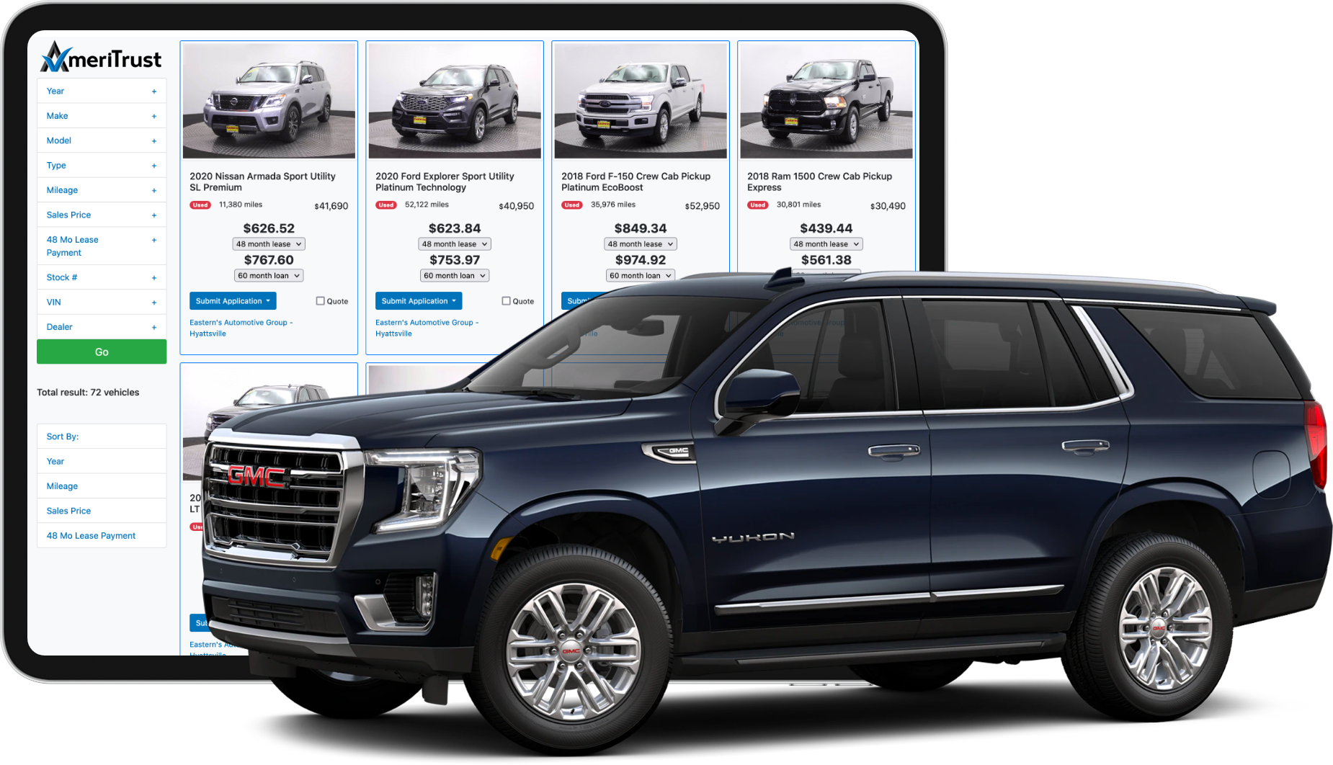


Contact Information
Phone | 1-800-600-6872
Email | info@ameritrust.com
Address | 777 Main Street Suite 3900 Fort Worth, TX 76102 USA
Address | 1100 Burloak Drive Suite 300 Burlington, ON L7L 6B2 CA
17

